Slide 1
Optimizing ML Pipelines: An In-Depth Analysis of WindTunnel's Methodology and Applications
A Comprehensive Review
Yongshu Cui
Peng Zhao
Xiaolin Liu
Ting Yang
2023/11/20

Slide 2
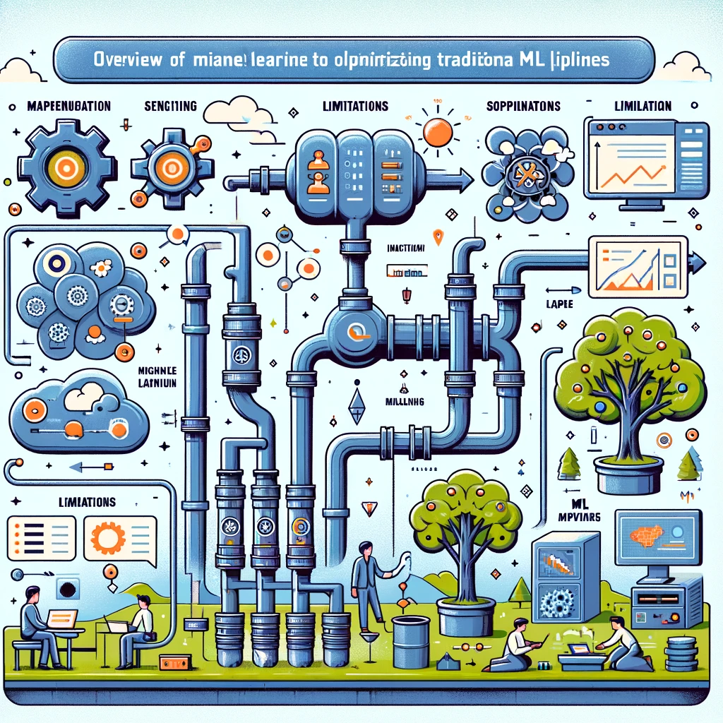
Introduction
Overview of machine learning pipelines and their importance in various fields.
Limitations of traditional ML pipelines.
The need for optimizing ML pipelines

Slide 3
WindTunnel: The Proposed Solution
Introduction to the WindTunnel method.
Key ideas: Layered differentiable programming and differentiable pipeline connections.
The goal of achieving differentiable ML pipelines.

Slide 4
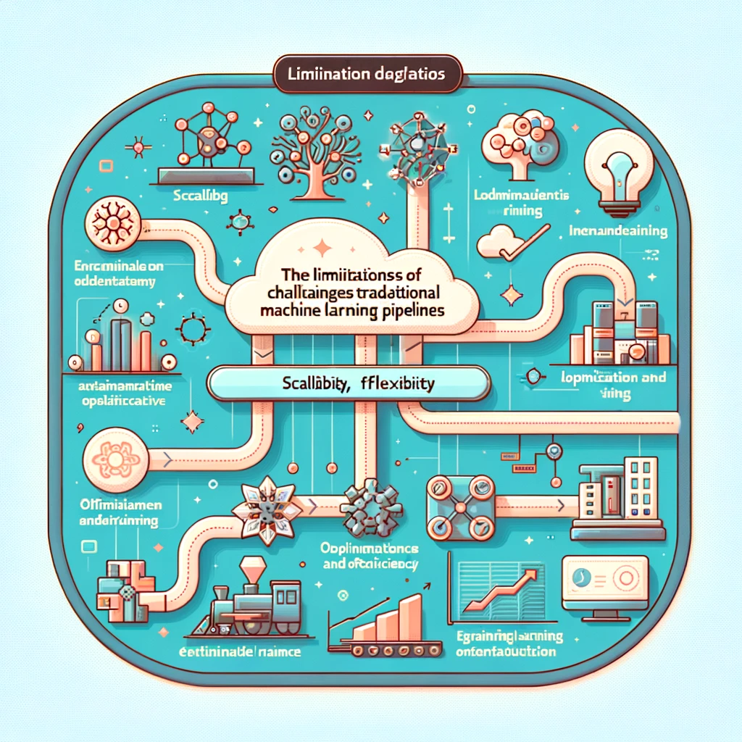
Problem Statement
1. The challenges with classical ML pipelines.
2. The gap between ML and Deep Neural Networks (DNNs) in terms of optimization and training.

Slide 5
Methodology of WindTunnel
Transforming ML pipeline components into neural network modules.
Differentiating between arithmetic and algorithmic operators.
Fine-tuning process and global optimization strategy.of optimization and training.
Operators Translation
Compose Modules
Fine-Tune

Slide 6
WindTunnel's currently support ML operators
Linear models
Normalizers
categorical encoders
SVM
PCA
LDA
Kmeans
naive bayes
random forest
gradient boosting tress
matrix factorization
factorization machine

Slide 7
Details inside the Wind Tunnel
Experimental setup
datasets :Flights,Avazu,Crtiteo
Experiments
Data pre-processing
Three different pre-processing schemas
Baseline model
Three ML pipelines
WindTunnel version (baseline model )
Wind Tunnel translate the three pipelines above
Overall performance
Metrics :AUC

Slide 8
Experimental setup
Flight dataset is utilized to forecast if a planned flight will experience a delay of 15 minutes or more
Avazu dataset on Kaggle is used for click-through rate prediction in online advertising.
Flight
Avazu
Criteo's Kaggle dataset is designed for predicting ad click-through rates based on user features.
For Flight,64.8% /35.2%
For Avazu,90%/10%
For Criteo,90%/10%
Criteo
Train/Test

Slide 9
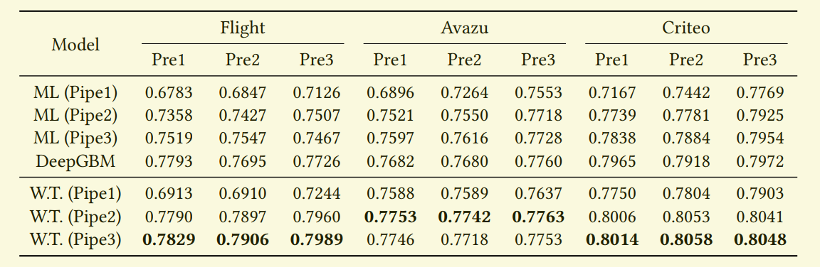
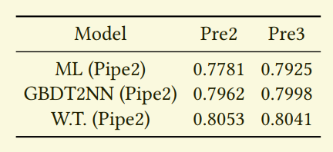
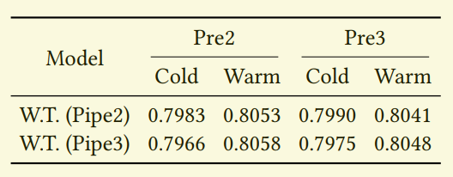
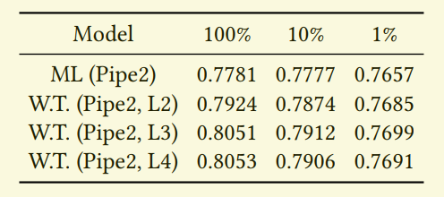
Performance
Overall performance comparison
We report AUC on test split following the previous work [24]. ML is the original ML pipeline, while W.T. is for WindTunnel. PreX means different preprocessing schemes, and PipeX denotes different ML pipelines. The best result is marked bold.
AUC of the Criteo dataset using different translation scopes. AUC of the Criteo dataset using different translation scopes.
AUC of the Criteo dataset using different GBDT parametrization levels and dataset sizes
(1%, 10%, 100%).
AUC of the Criteo dataset using different parameter initialization regimes

Slide 10
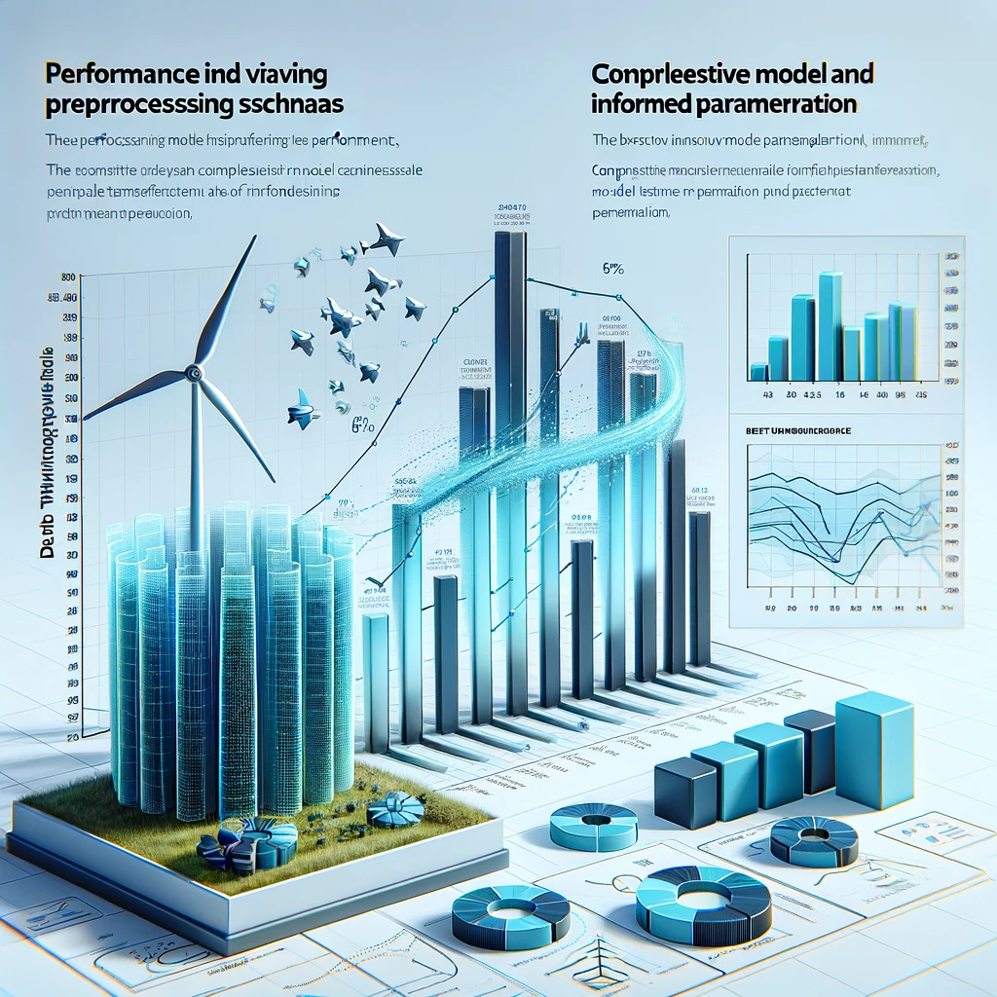
Insights from the Experiments
Performance improvements achieved with WindTunnel.
Impact of varying preprocessing schemas on model performance.
Benefits of comprehensive model translation and informed parameterization.

Slide 11
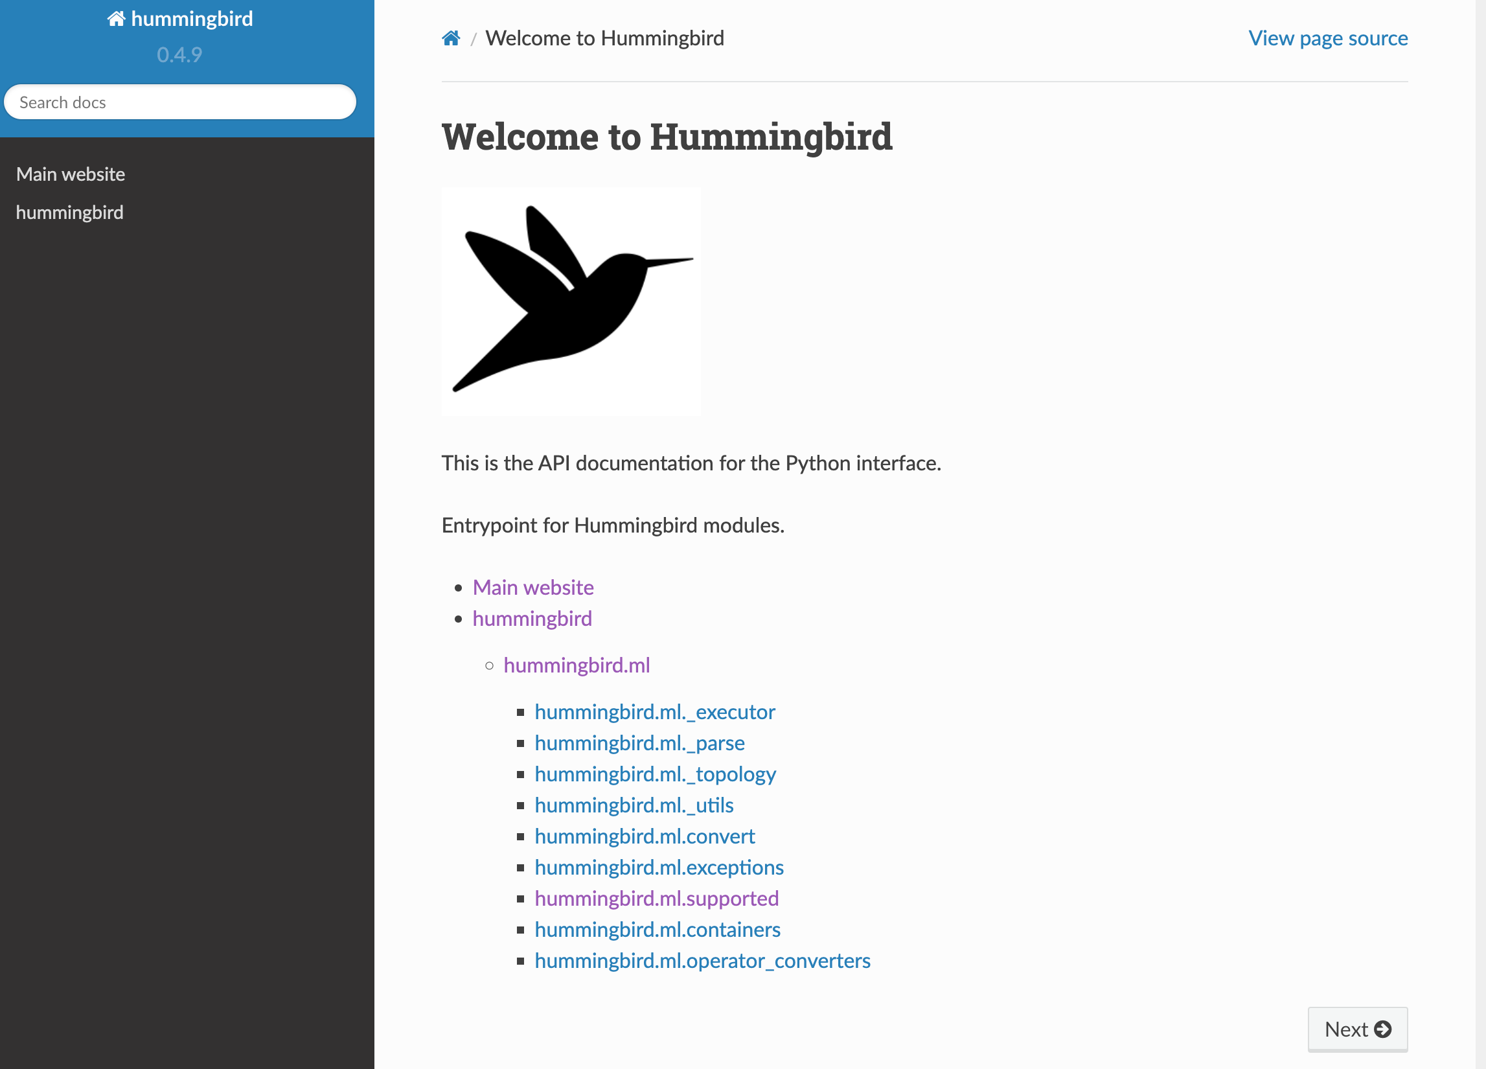
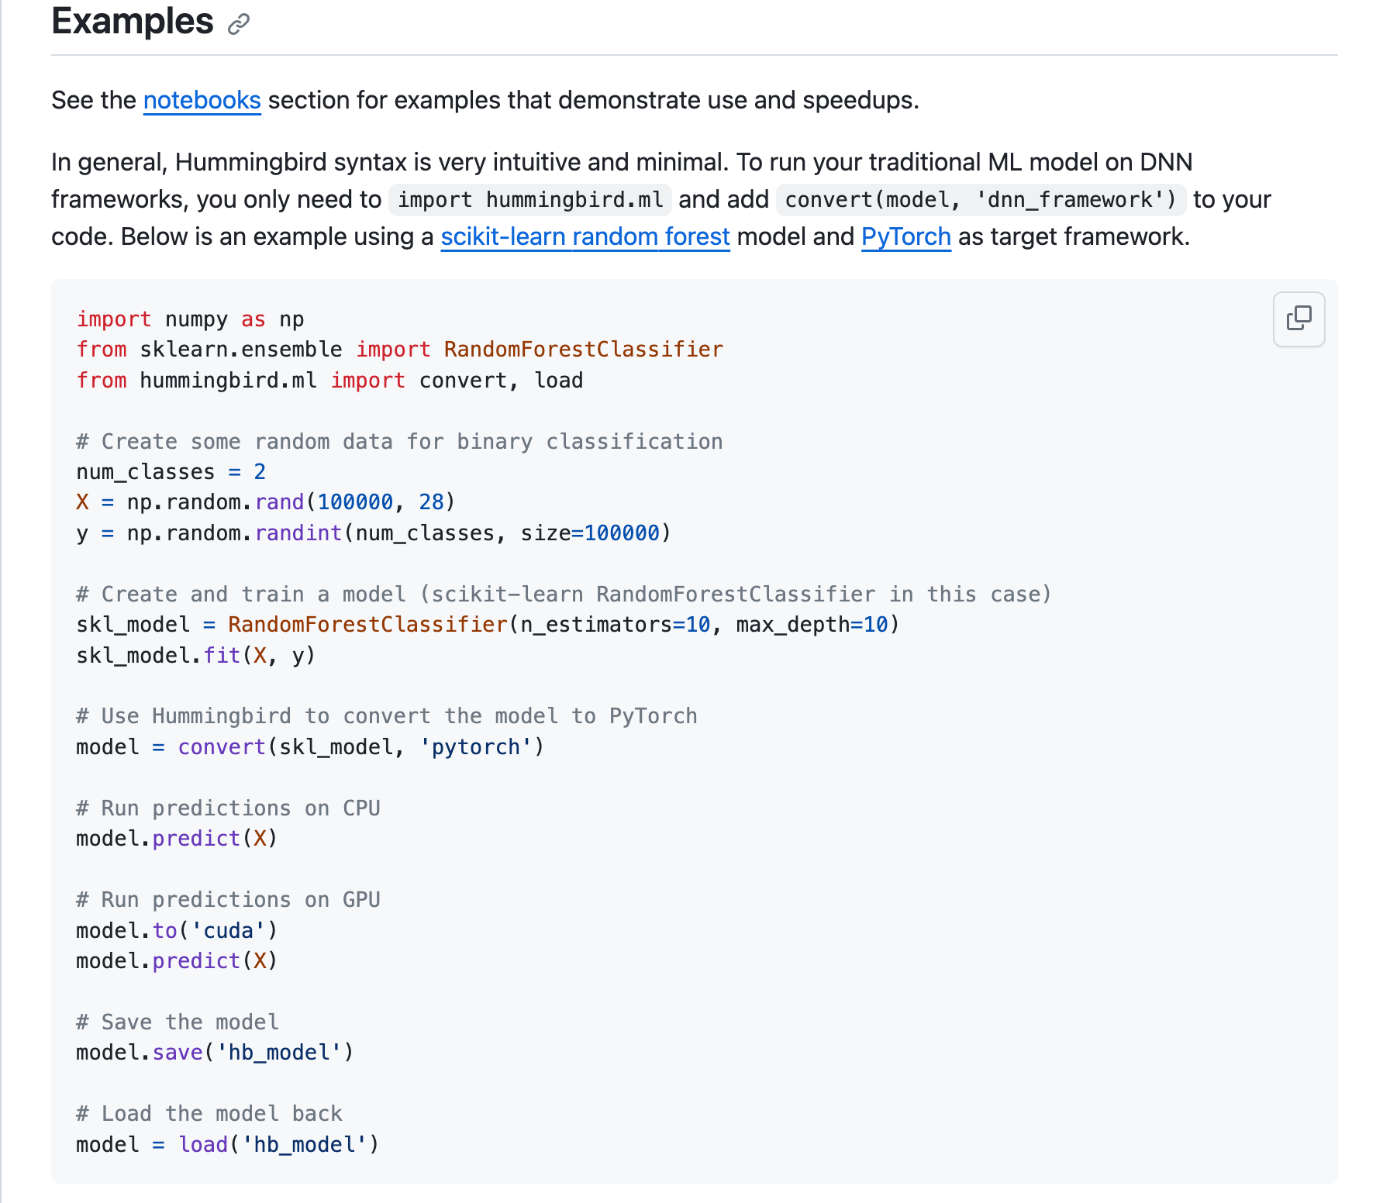
The WindTunnel can be useful in production

Slide 12
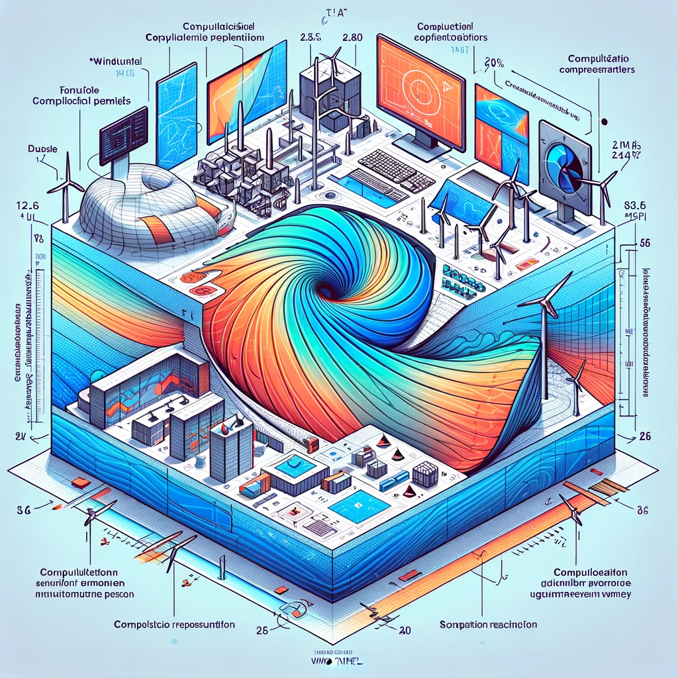
Limitations and Future Work
Discuss the computational demands and challenges of WindTunnel.
Potential areas for future research and improvement.

Slide 13
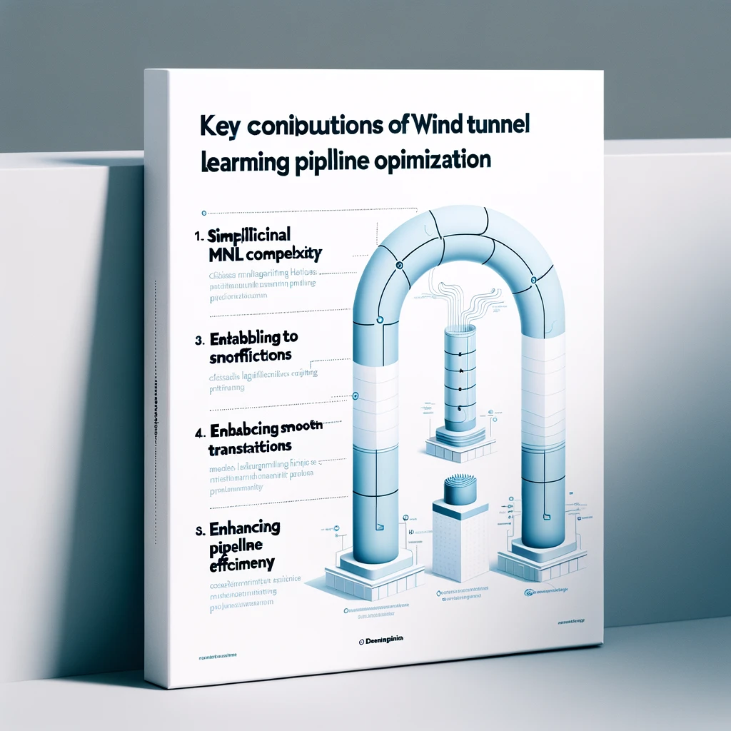
Conclusion
Summary of WindTunnel's impact on ML pipeline optimization.
Its role in bridging the gap between classical ML and DNNs.

Slide 14
Thank you very much for watching !

